Slide 1
AI-Powered Guest Experience
Revolutionizing hospitality through AI-driven personalization

Slide 2
Introduction
This presentation will explore an AI-powered system designed to enhance guest experiences in the hospitality sector through personalization techniques and real-time data analysis.

Slide 3
01
Objective

Slide 4
Revolutionizing guest experiences
The AI-Powered Guest Experience Personalization System aims to transform how guests interact with hospitality services, providing tailored recommendations based on individual preferences and behavior. This system utilizes advanced algorithms to analyze data, ensuring that each guest receives the best possible service during their stay, thereby enhancing satisfaction and creating memorable experiences.

Slide 5

Dynamic recommendations
Dynamic recommendations are generated based on guest data analysis, taking into account previous stays, preferences, and real-time inputs. This feature allows the hotel to suggest tailored offers, services, or experiences that resonate with each individual guest, significantly improving their stay and likelihood of return. The recommendation engine continuously learns and adapts to ensure relevance over time, ultimately building guest loyalty and satisfaction.

Slide 6
Real-time feedback analysis
Real-time feedback analysis leverages immediate guest input to assess their experiences and satisfaction levels as they occur. This allows hospitality providers to address any issues instantly, adjusting services proactively rather than reactively. By utilizing data from reviews, surveys, and direct communication, hotels can implement quick changes that enhance guest experiences, ultimately leading to higher satisfaction and loyalty.

Slide 7
02
Modelling

Slide 8
Why XGBoost ?
Choice of XGBoost : XGBoost was chosen for its efficiency in handling large-scale datasets and delivering precise predictions.
Imbalanced Dataset Handling: Its intrinsic mechanisms address class imbalance effectively, enhancing model reliability in discount prediction applications.
Performance Comparison: XGBoost outperforms traditional models like linear regression and decision trees in predictive accuracy and robustness.

Slide 9
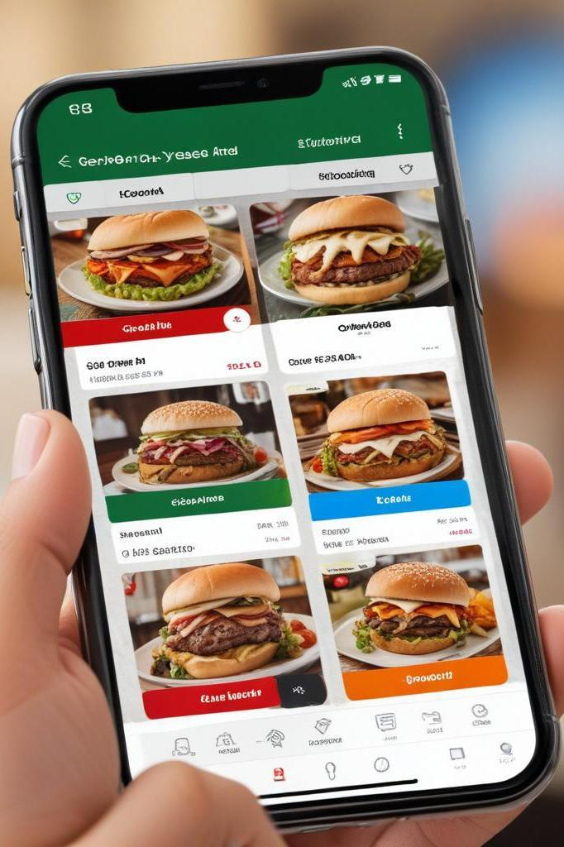
Coupon recommendation
The coupon recommendation system identifies suitable discounts and offers for guests based on their previous preferences, booking history, and current trends. By analyzing data, it can predict which coupons are more likely to entice guests, maximizing utilization and enhancing their experience. This personalized approach not only benefits the guests but also boosts hotel revenue through targeted marketing strategies.

Slide 10
Retrieval-Augmented Generation (RAG) System
Understanding RAG System: Retrieval-Augmented Generation integrates information retrieval with generative models to enhance decision-making in hospitality.
Components Overview: Key components include retrieval of relevant guest reviews and summarizing insights to inform personalized service.
Personalization Applications: RAG systems provide tailored responses and recommendations, fostering enhanced guest satisfaction through engagement

Slide 11
03
User Interface

Slide 12
AI–powered User Booking Page
The AI-Powered User Booking Page enhances the hospitality experience by providing a seamless and personalized booking process. Guests can select their room preferences, check-in/check-out dates, and amenities while also choosing their preferred cuisine for tailored dining recommendations. The system uses AI to generate personalized discount coupons based on user preferences and past interactions, ensuring cost savings and exclusive deals. Once the booking is confirmed, an instant email is sent with all details, including applied discounts and a personalized welcome message. Guests can also submit real-time feedback, which AI analyzes to improve future experiences, rewarding them with loyalty points or additional discounts. This intelligent system ensures a smooth, engaging, and rewarding experience for guests while optimizing service for hotels.

Slide 13
Real-time review submission
The real-time review submission feature allows guests to provide instant feedback about their experiences throughout their stay, using mobile devices or in-room technology. This immediate channel for feedback enables hotels to quickly address concerns and improve services on the spot, fostering a culture of responsiveness that enhances guest satisfaction and loyalty.

Slide 14
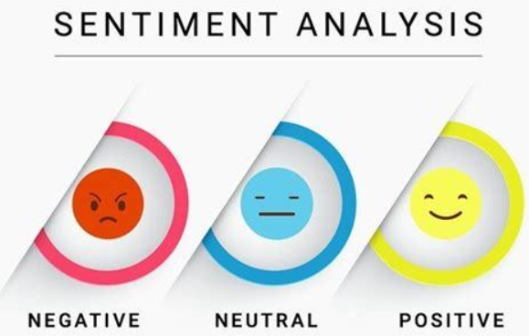
Review and Sentiment Analysis
The AI-powered Review and Sentiment Analysis system processes guest feedback using NLP and machine learning to classify sentiments as positive, neutral, or negative. This helps hotels identify strengths, address concerns proactively, and optimize services. AI-driven insights enable personalized responses, enhancing guest satisfaction and loyalty while continuously improving the hospitality experience.

Slide 15
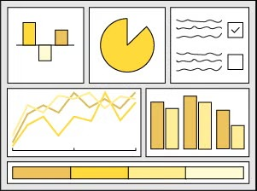
Insightful Dashboards
Dashboard Visualization Features: Dash and Plotly provide interactive dashboards that visualize guest behavior, informing strategic management decisions.
Guest Preference Insights: Dashboards highlight trends in guest preferences, enabling tailored strategies that enhance user engagement and loyalty.
Management Engagement Tools: Real-time analytics empower management with actionable insights, improving responsiveness to evolving guest expectations.

